Slide 1
Research Progress Presentation 1
Lim Liang Sun (B4)

Slide 2
Outline
Research topic
Problem setting
Simulation environment
Future work

Slide 3
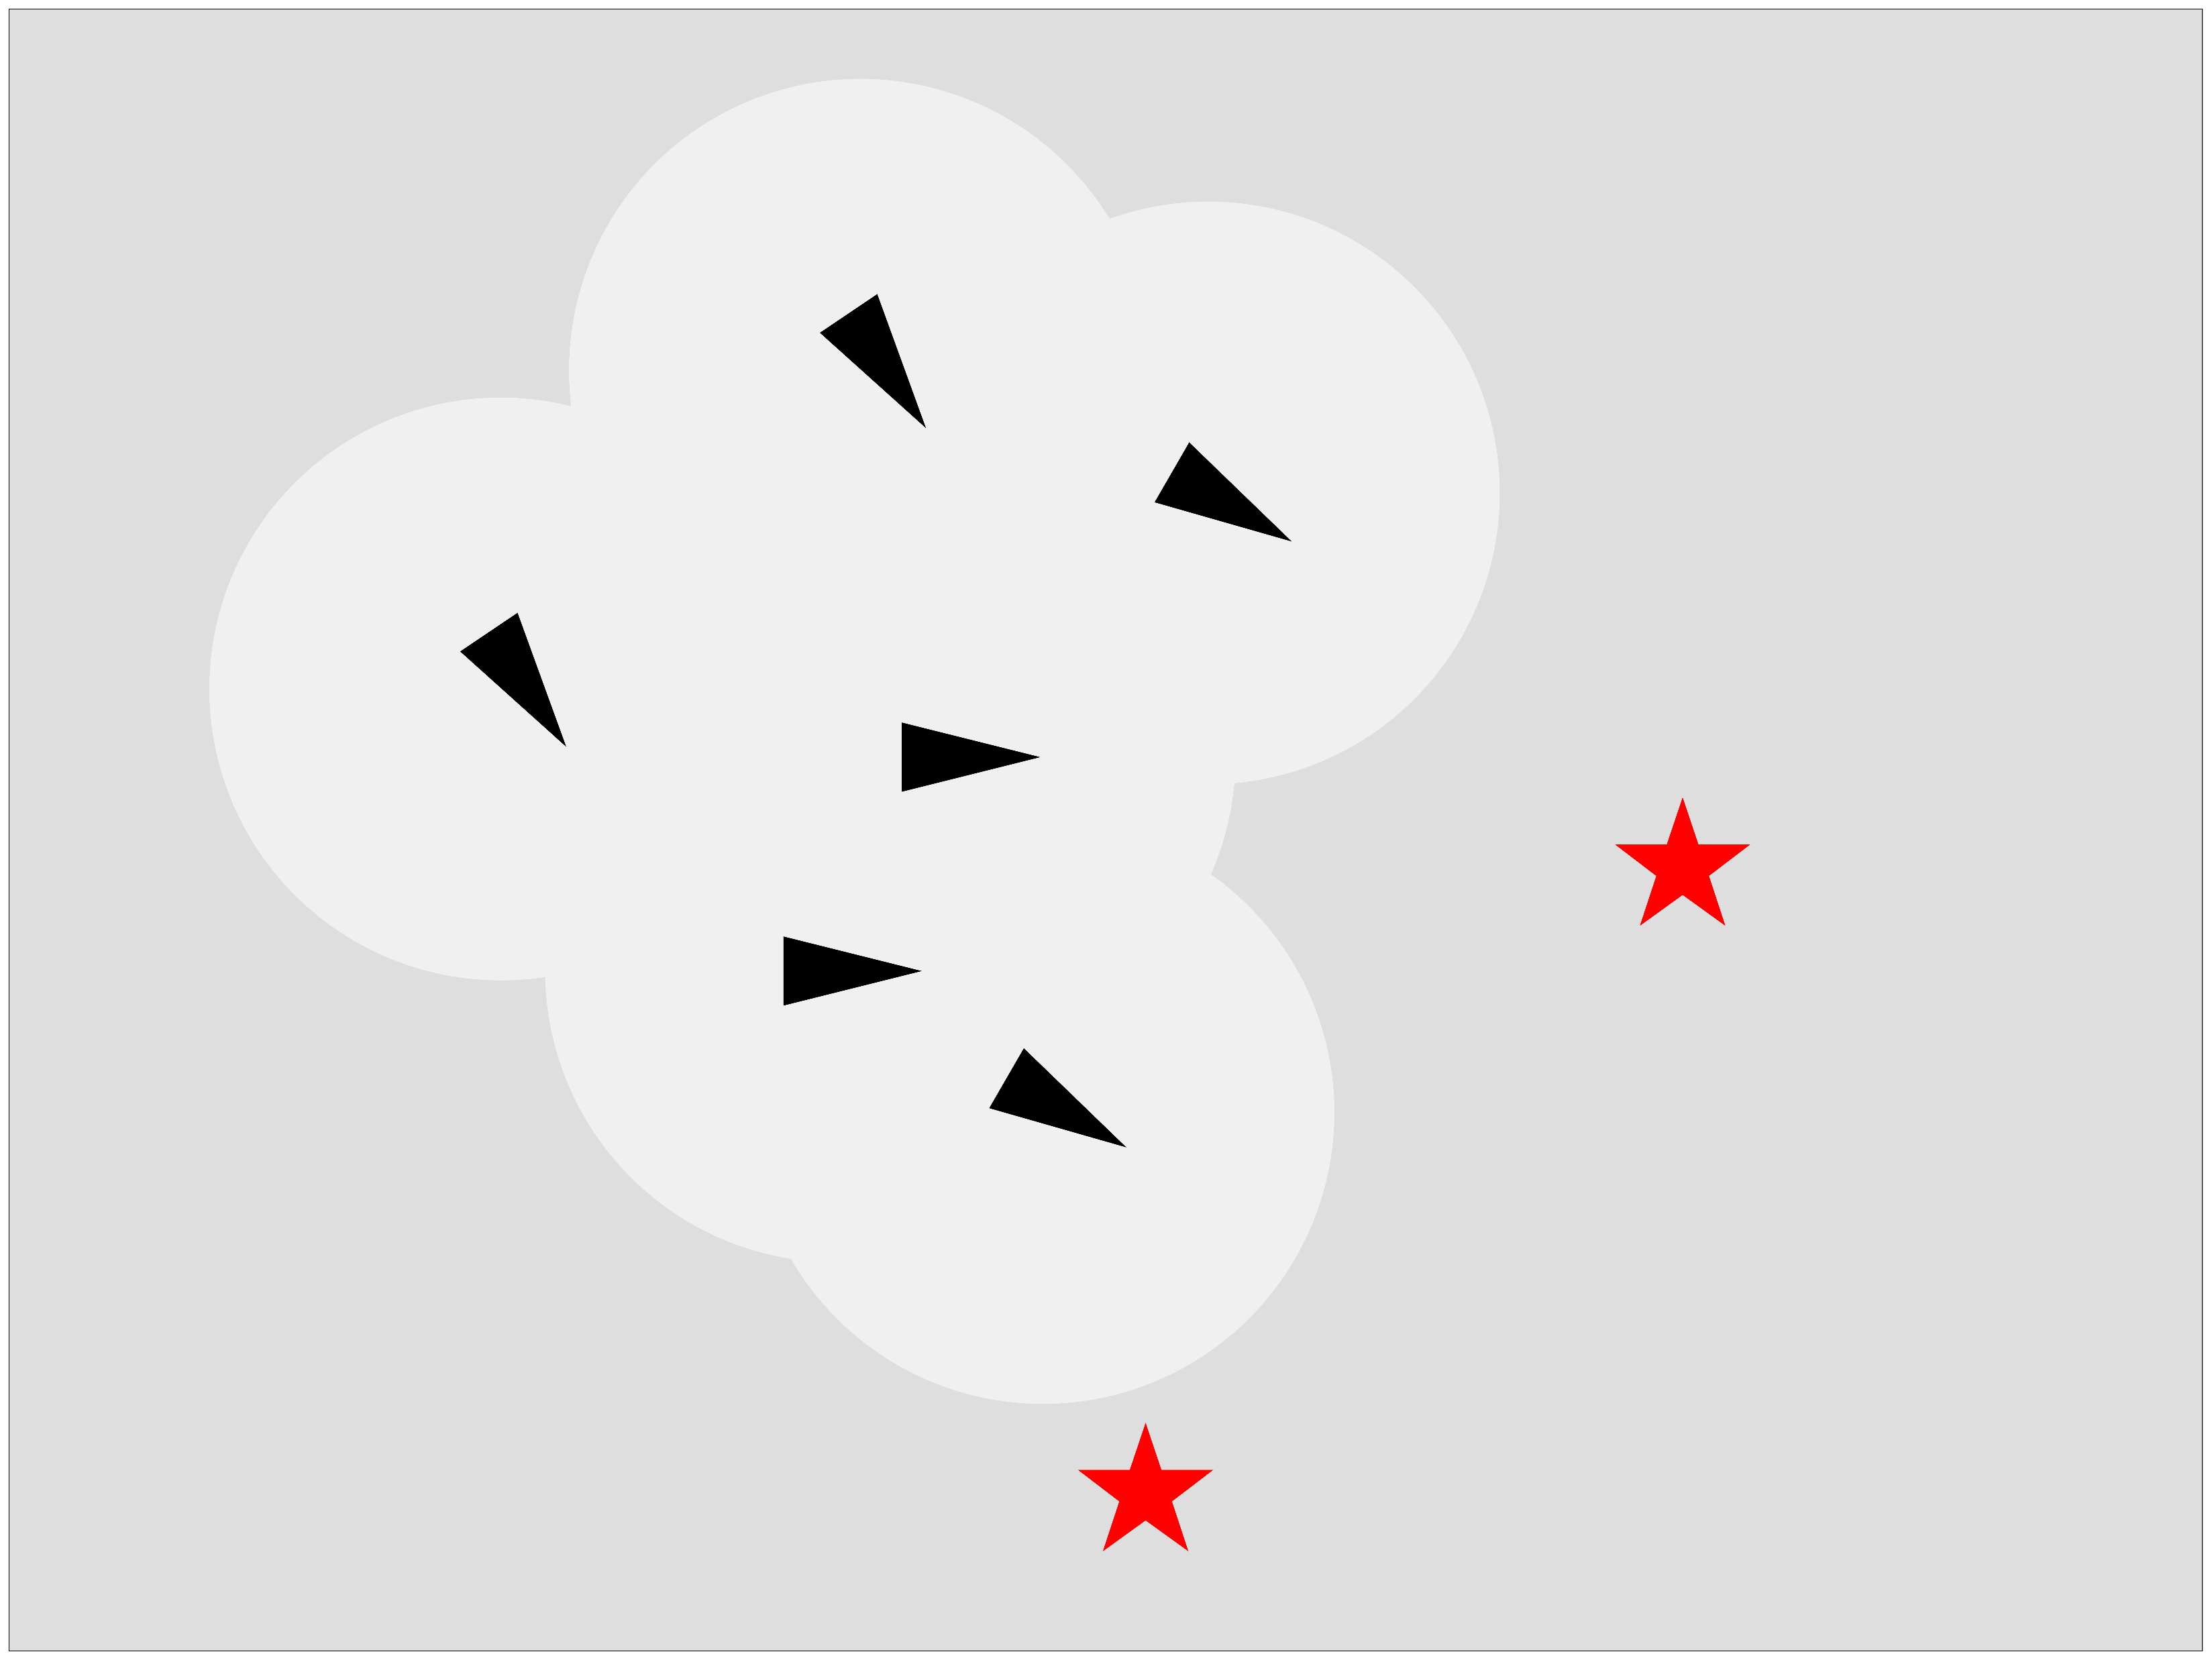
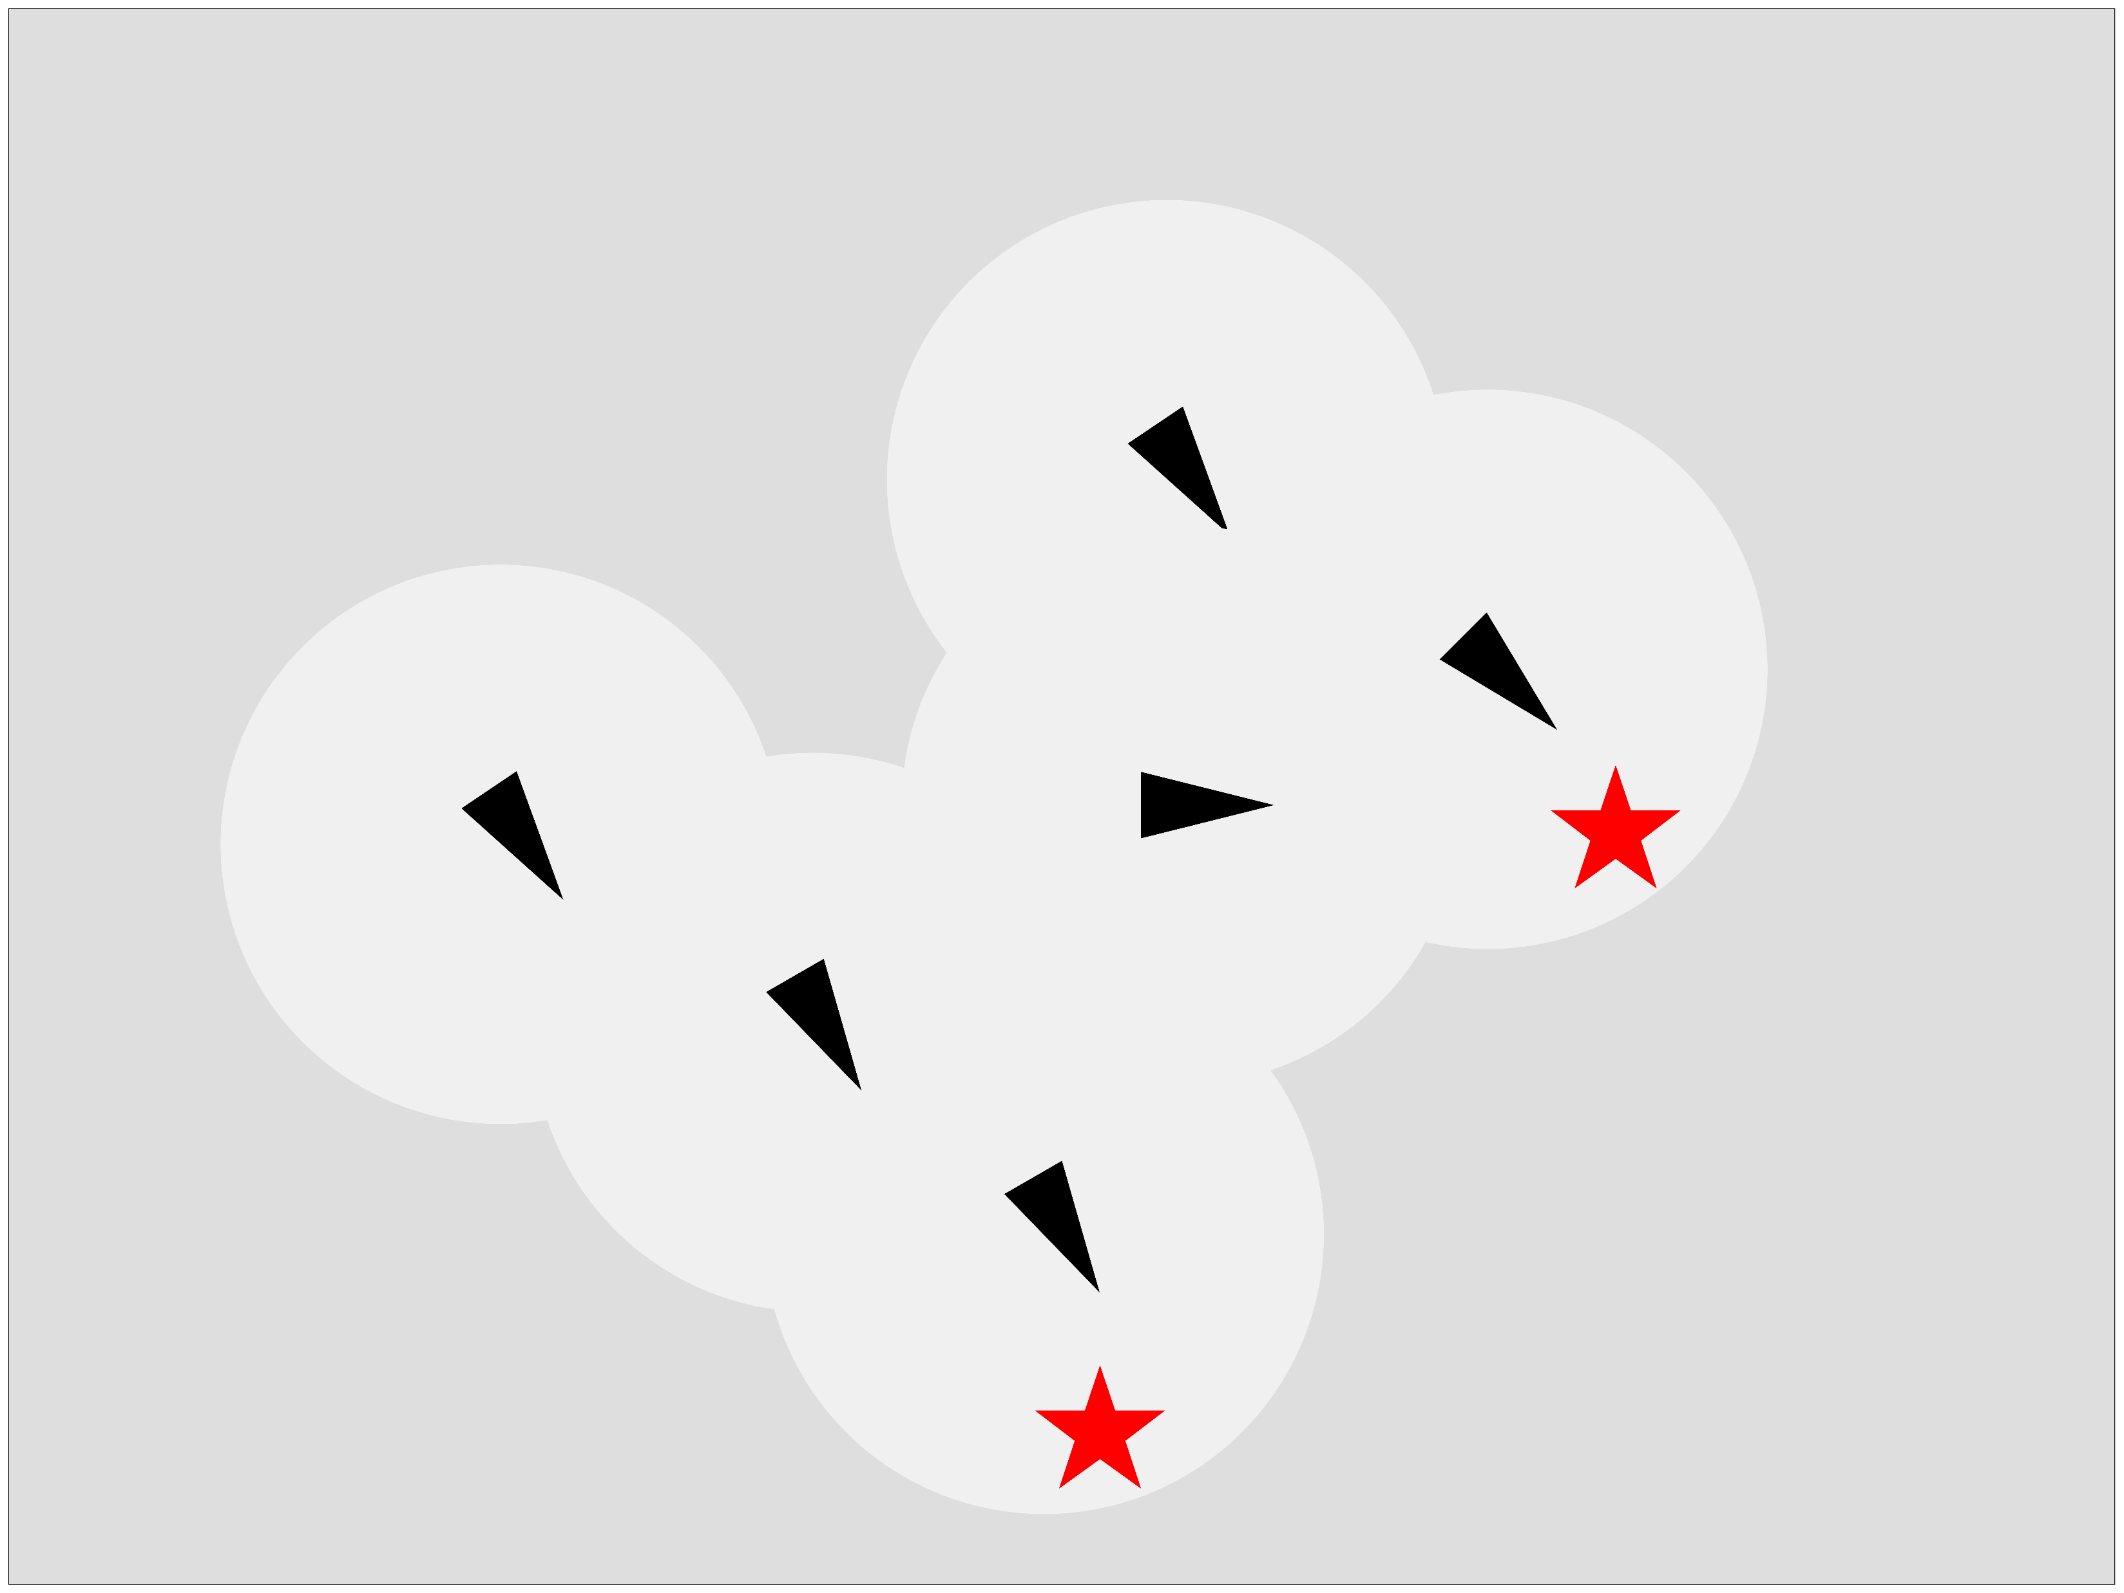
Research topic
Coverage and task splitting of multi-agent flocks with distributed control
Goal
cover all point of interests (POIs) in an unmapped region

Slide 4
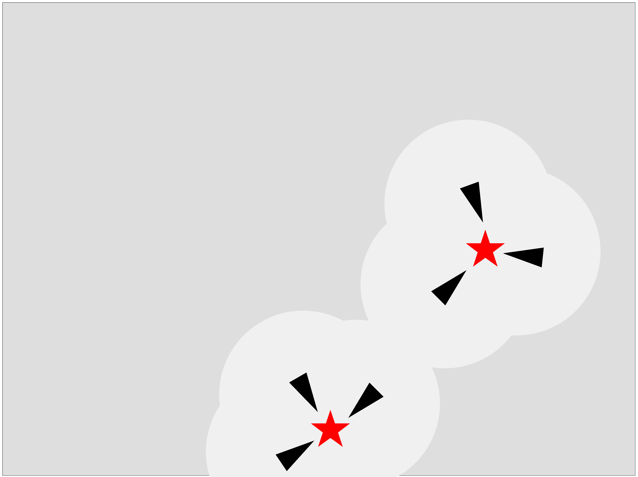
Problem Setting
Bounded unmapped 2D area
POI can appear any time
Send 3 boids to each POI for task completion
Continue swarming

Slide 5
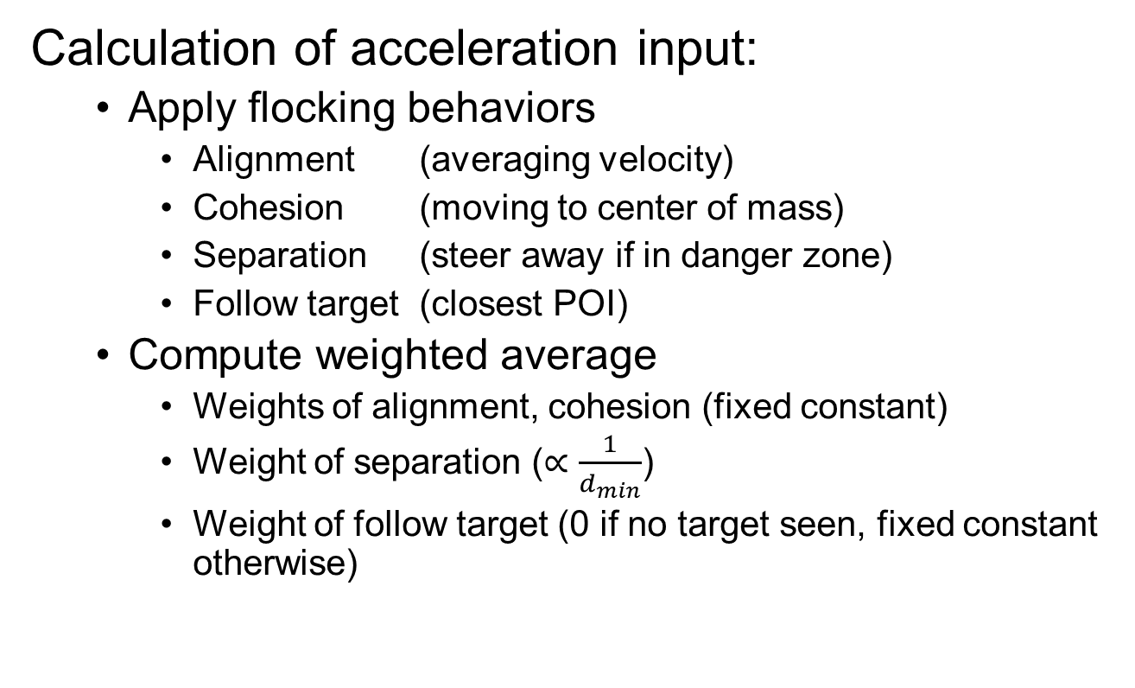
Simulation Environment (1)
Calculation of acceleration input:
Apply flocking behaviors
Alignment (averaging velocity)
Cohesion (moving to center of mass)
Separation (steer away if in danger zone)
Follow target (closest POI)
Compute weighted average
Weights of alignment, cohesion (fixed constant)
Weight of separation ($∝\frac{1}{d_{min}}$)
Weight of follow target (0 if no target seen, fixed constant otherwise)

Slide 6
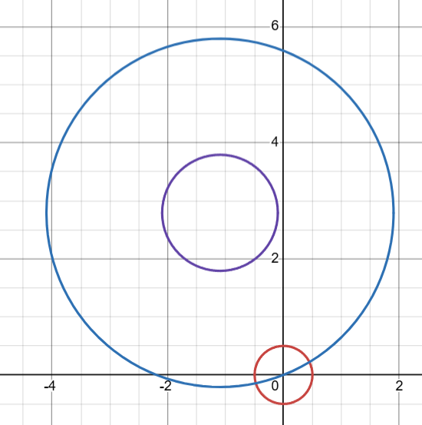
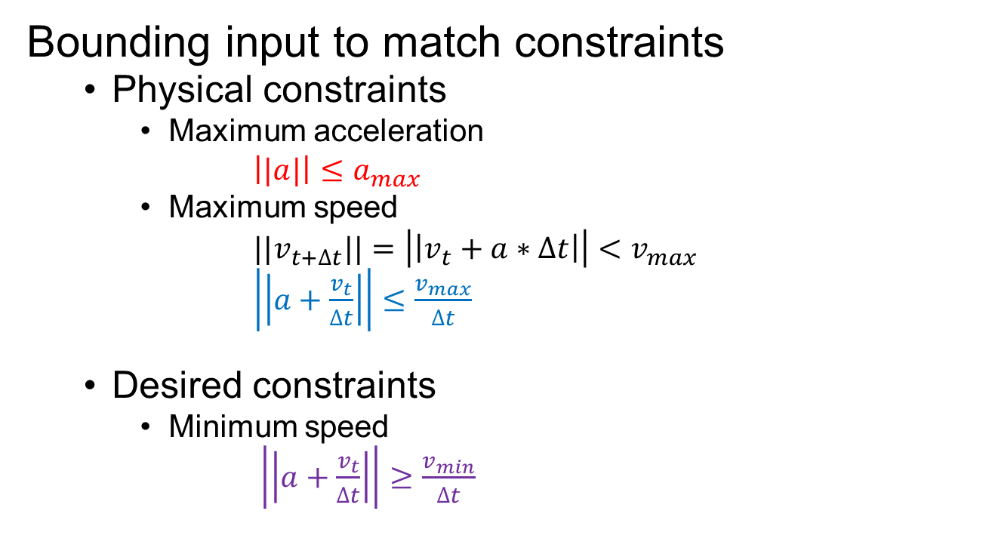
Simulation Environment (2)
Bounding input to match constraints
Physical constraints
Maximum acceleration
$\left||a|\right|≤a_{max}$
Maximum speed
${||v}_{t+∆t}||=\left|\left|v_{t}+a∗∆t\right|\right|<v_{max}$
$\left|\left|a+\frac{v_{t}}{∆t}\right|\right|≤\frac{v_{max}}{∆t}$
Desired constraints
Minimum speed
$\left|\left|a+\frac{v_{t}}{∆t}\right|\right|≥\frac{v_{min}}{∆t}$

Slide 7
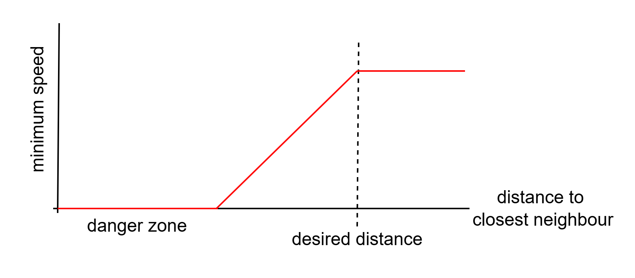
Simulation Environment (3)
Design of minimum velocity constraint
Promote exploration
While still prioritizing no collisions

Slide 8
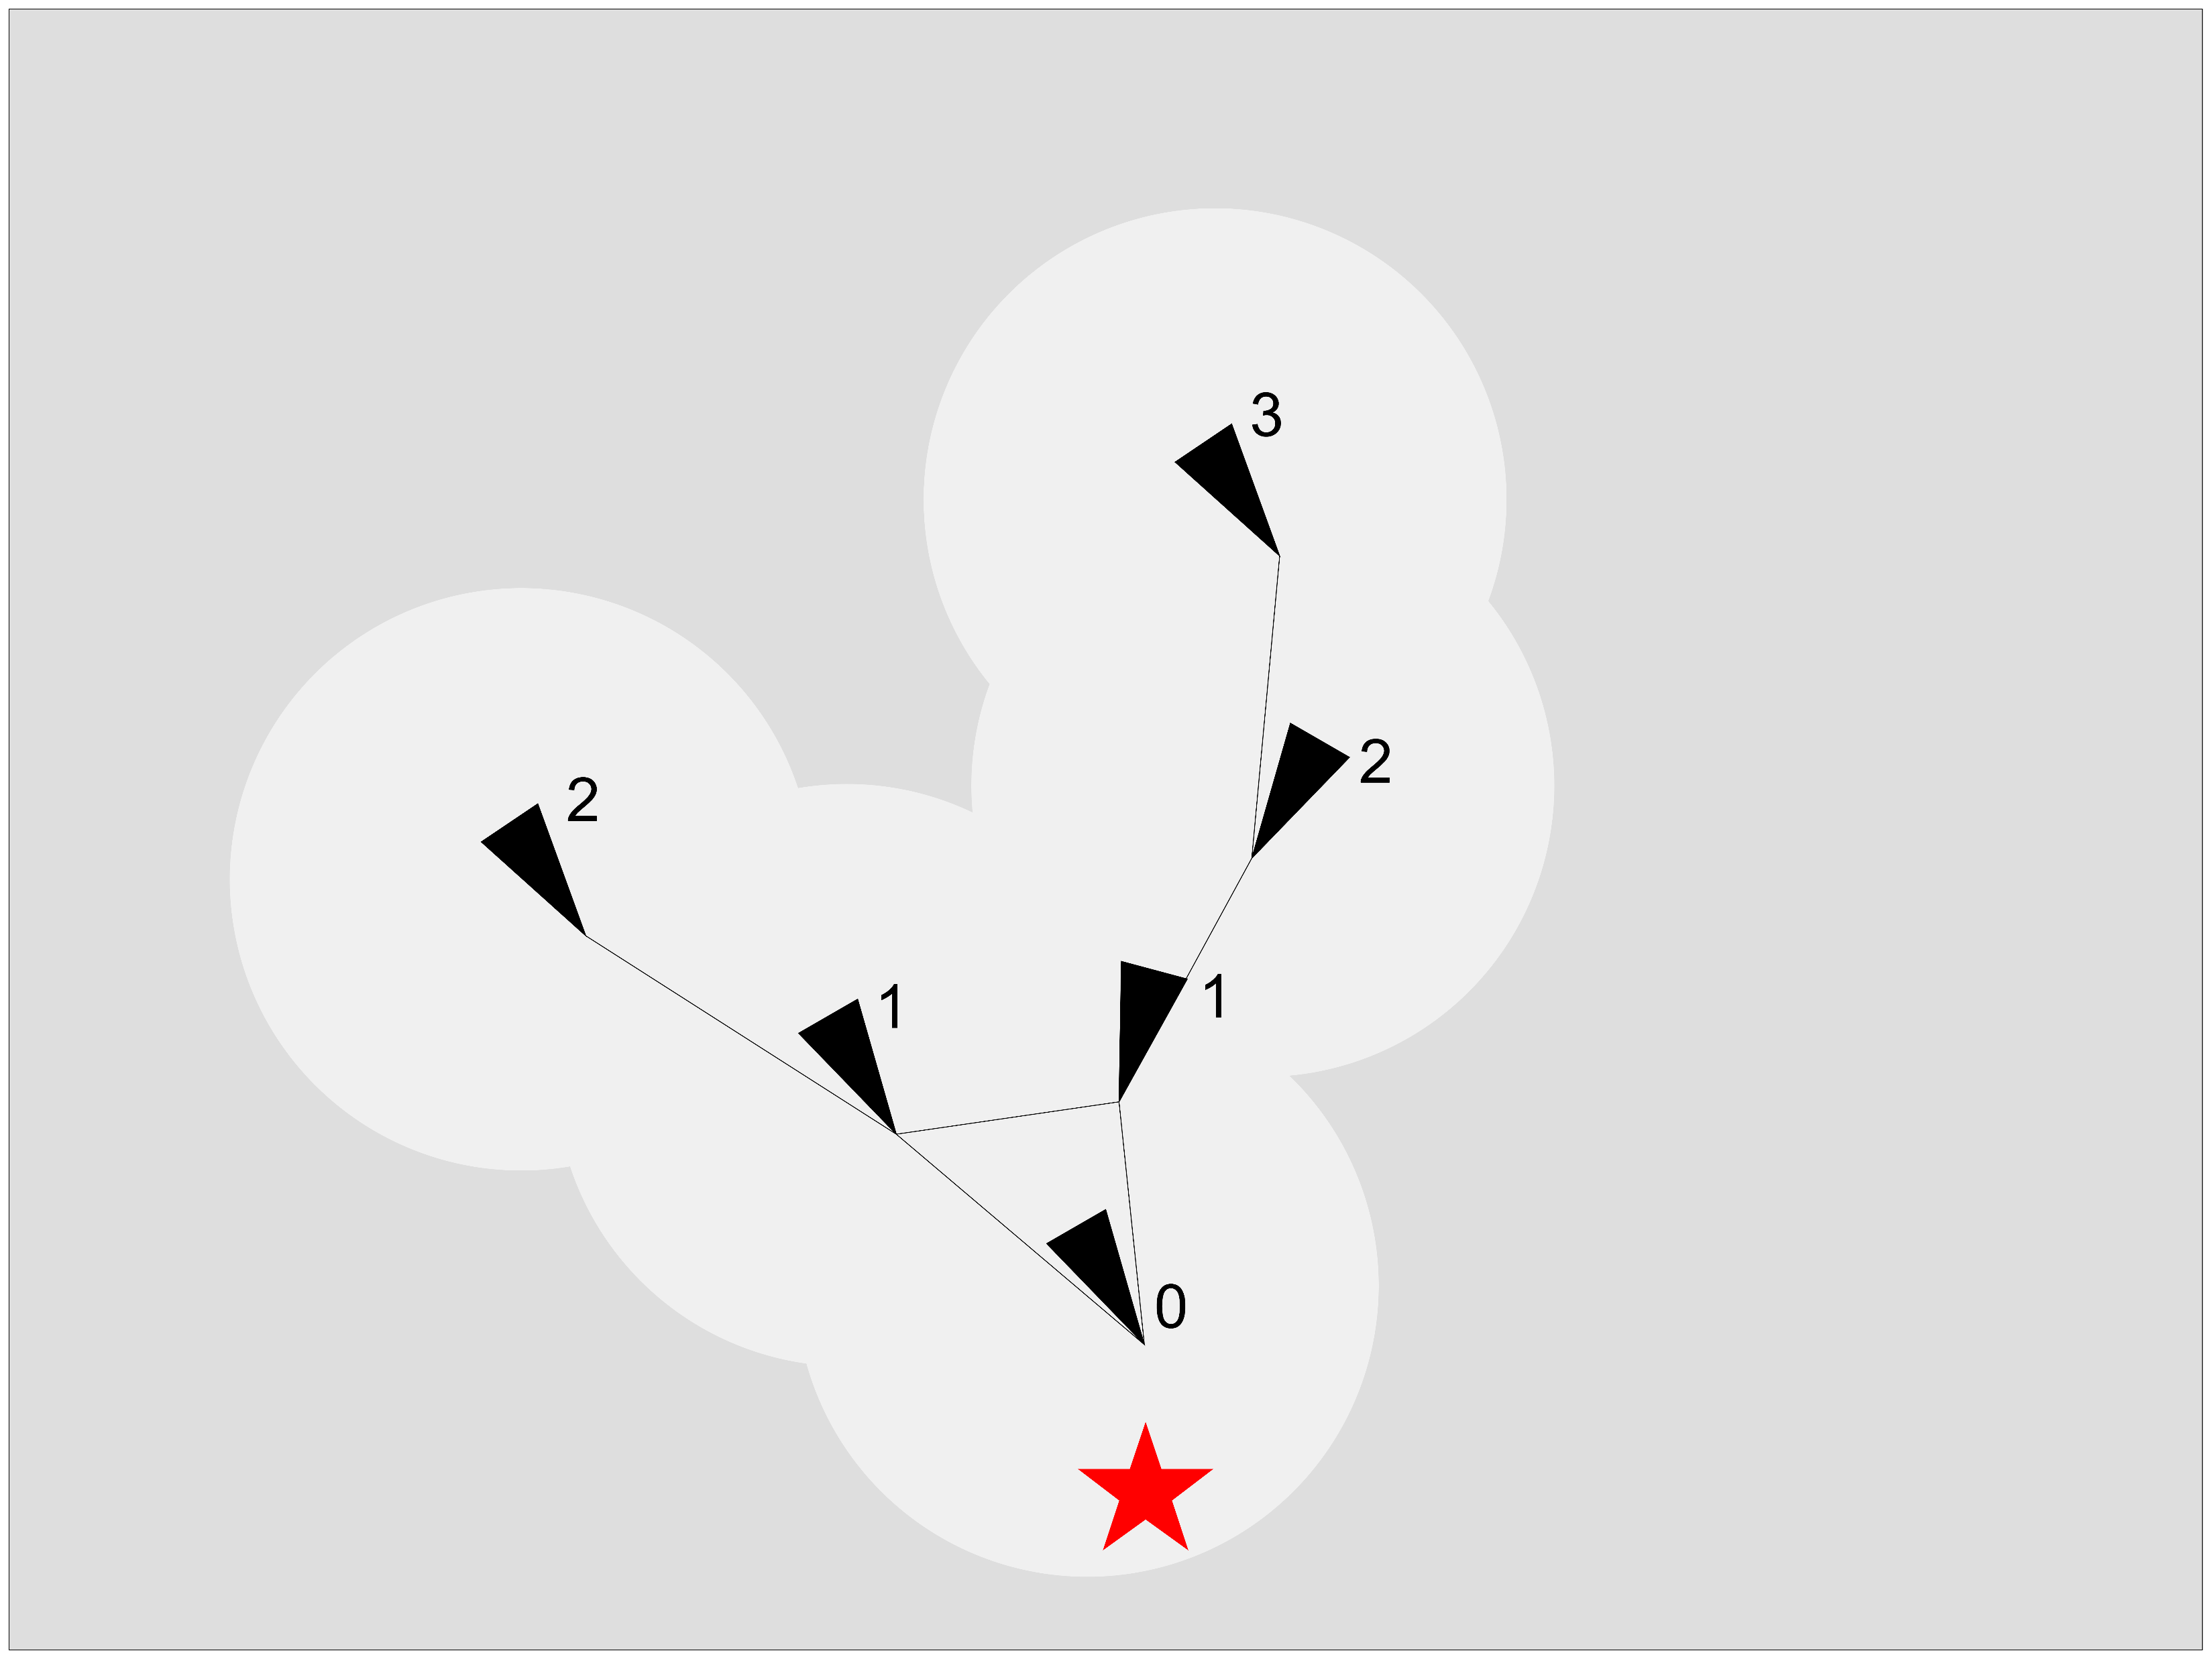
Simulation Environment (4)
Ranking System
higher weight (2x) to lower rank neighbors
normal weight (1x) to same rank neighbors
lower weight (0.5x) to higher rank neighbors

Slide 9
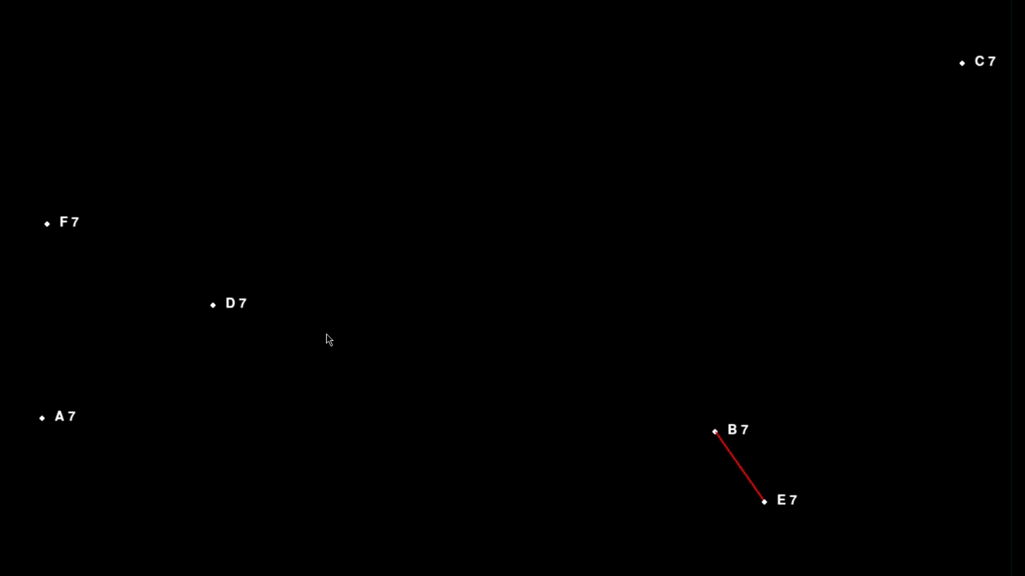
Simulation Video

Slide 10
Future Work
Target identification method
Expand ranking system to handle multiple targets
Add obstacles to avoid

